Slide 1
Handwritten word recognition
Professor Len Macini
Phanindra kumar
Sreya Chowdary Nagineni
Sai Swetha Vadrevu

Slide 2

Project Description
This project centers on the development of an Artificial Intelligence (AI) system capable of accurately recognizing and transcribing handwritten words from images. The primary goal is to create a robust model that can decipher handwritten text, aiding in the automation of text recognition tasks.

Slide 3
Business Problem
Time-Consuming: Manual transcription of handwritten documents is labor-intensive and time-consuming, especially for large volumes of text.
Cost Inefficiencies: Employing personnel for manual transcription incurs significant costs, especially for businesses dealing with extensive handwritten documents.

Slide 4
Model Information
Dataset – We have used IAM Dataset, which is a collection of handwritten words, letters etc.
Type: The model is a deep learning-based sequence recognition model, specifically designed for Handwritten Text Recognition
Pretrained/Trained: It is a trained model for handwritten word recognition.
Network/Algorithm: The model architecture is based on Convolutional Neural Networks (CNNs)
Edit distance: Edit distance is a string metric, i.e. a way of quantifying how dissimilar two strings (e.g., words) are to one another, that is measured by counting the minimum number of operations required to transform one string into the other. (Average 5)
Predictions: The model predicts the text content present in the uploaded image of handwritten words.

Slide 5
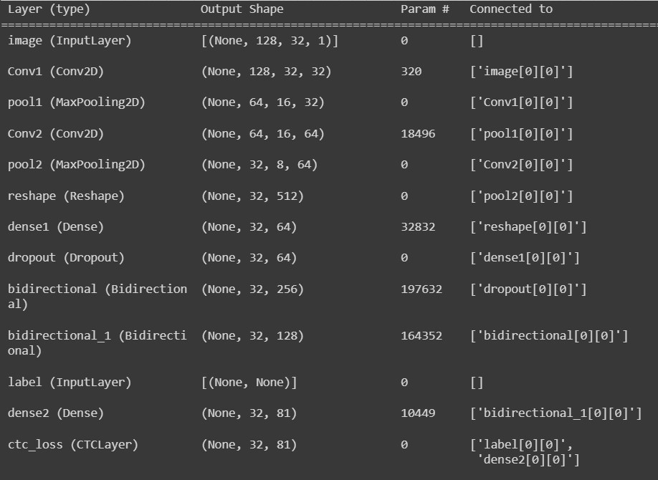
Model Algorithm

Slide 6
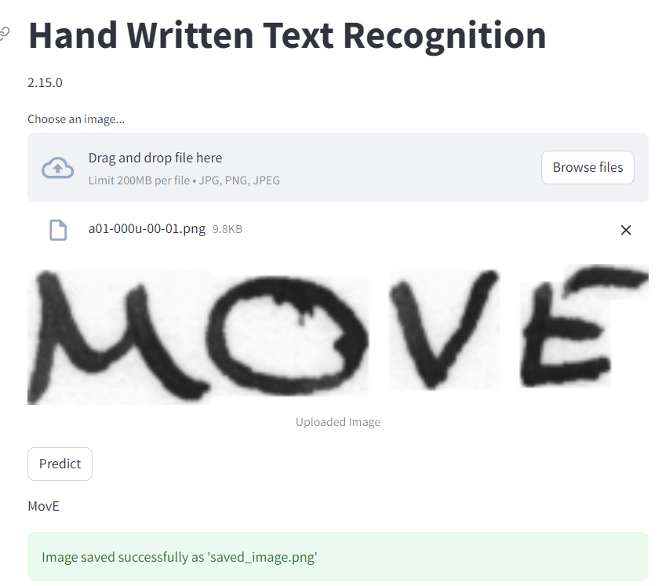
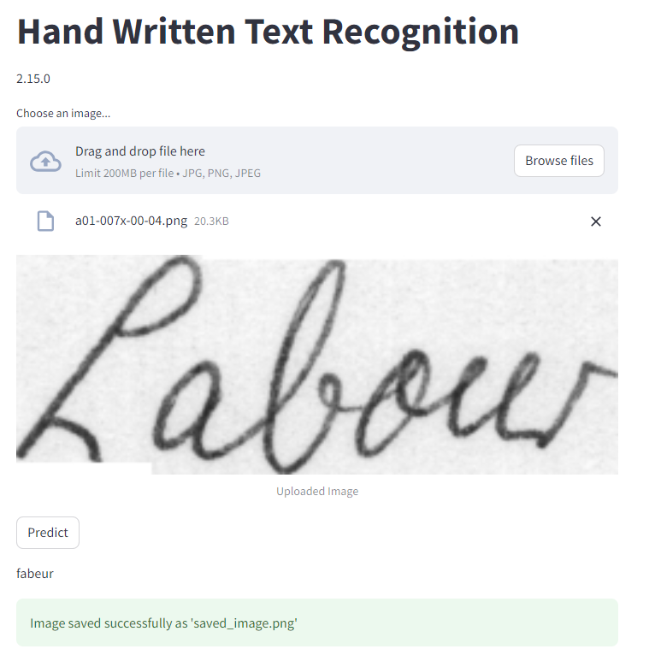
Results:
https://sharp-cycles-design.loca.lt/ 35.185.203.167

Slide 7
Challenges
Training : It is hard to train a big neural network on jetson nano, because of memory constraints.
Limited computational power
We faced issues with python libraries such as TensorFlow, stream lit etc.
Tensorflow version – 2.15.0

Slide 8
Use cases:
Banking and Finance: Processing handwritten checks, forms, or financial documents for automated handling and verification.
Package and Address Recognition: Reading handwritten addresses on packages or envelopes to facilitate sorting and delivery logistics.
Education and Assessment: Scanning and digitizing handwritten exams, quizzes, or notes for grading and analysis.
Healthcare Records: Converting handwritten medical notes or prescriptions into digital text for easier retrieval and analysis in healthcare settings.
Languages and Translation: Recognizing handwritten text in various languages and aiding in translation services.
Interactive Interfaces: Enabling users to interact with devices through handwritten input, such as digital tablets or touchscreens.

Slide 9

Thank you!

